Slide 1
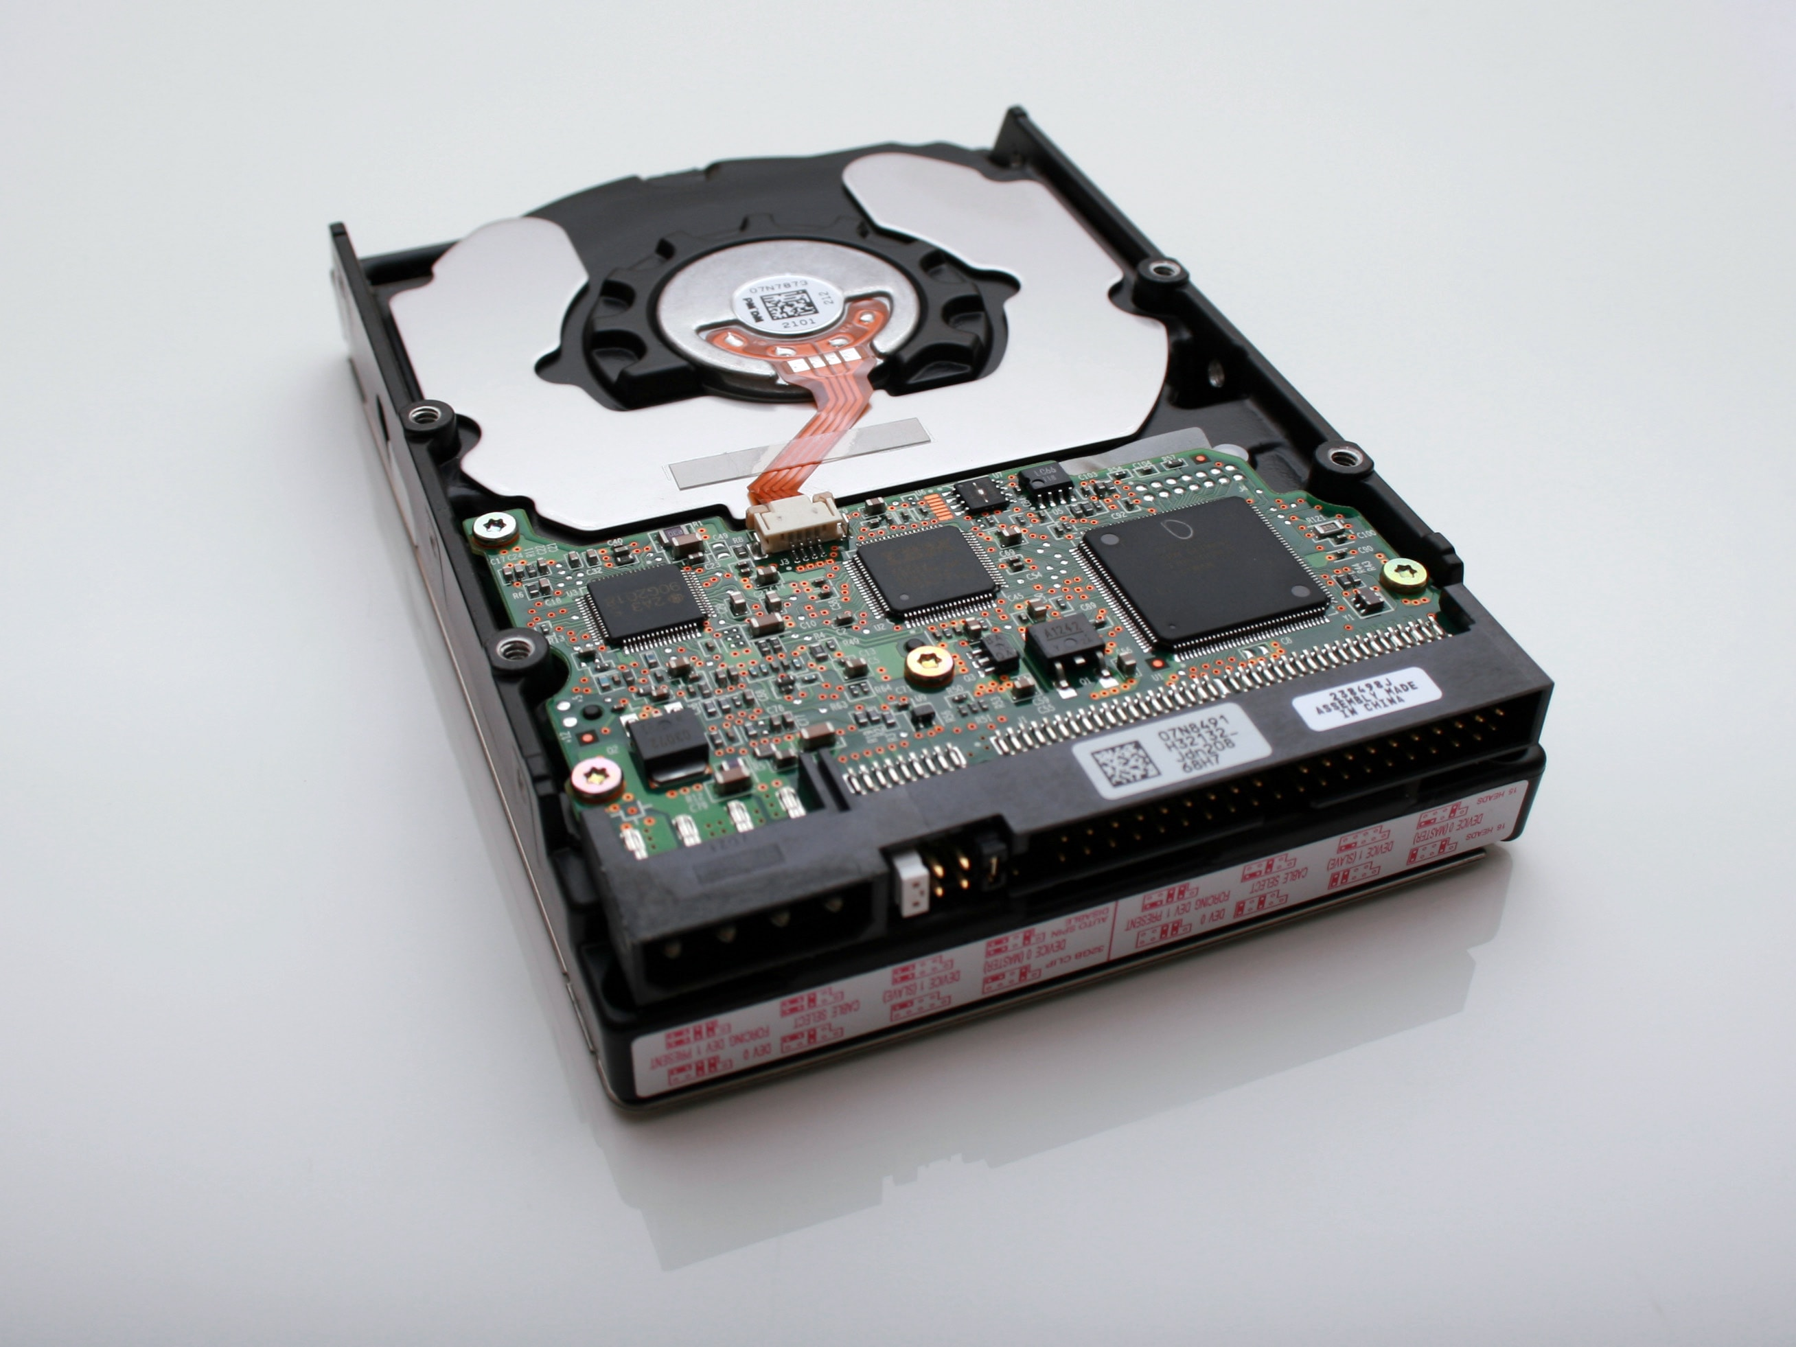
Understanding Kubernetes Storage
Mateusz Dymiński

Slide 2
whoami
Mateusz Dymiński
Software Developer at Nokia
5+ exp with Java
5+ exp with Go
One of the organizer GoWroc - Golang Wroclaw Meetup
Github: github.com/mateuszdyminski
Twitter: @m_dyminski
LinkedIn: linkedin.com/in/mdyminski

Slide 3
Agenda
Challenges in Stateful Containers
Volume Plugins
Stateful Applications
Storage Features
Container Storage Interface
MythBusters
Summary

Slide 4

github.com/mateuszdyminski/storage

Slide 5
Database in Pod
apiVersion: apps/v1
kind: Pod
metadata:
name: mysql
spec:
containers:
- image: mysql:5.6
name: mysql
env:
- name: MYSQL_ROOT_PASSWORD
value: password
ports:
- containerPort: 3306
name: mysql
What happen with data
when container ends?
All the data is lost

Slide 6
Problems with stateful containers
Containers are ephemeral by design
Container termination/crashes result in loss of data
Containers can’t share data between each other.
Can’t run stateful applications
Unless the storage is provisioned and attached to container by Volume Plugin

Slide 7
Volume Plugin
A way to reference block device or mounted filesystem
Ordered Volume is accessible by all containers in pod
Volume plugin specifies
How volume is setup in pod
Where the data resides
Lifetime of volume could be longer than lifetime of pod

Slide 8
Kubernetes Storage
File Storage
NFS, SMB, etc.
Block Storage
GCE PD, AWS EBS, iSCSI, Fibre Channel, etc.
File on Block Storage
Data Path Standarized – Posix, SCSI

Slide 9
Kubernetes Volumes Plugins
Remote Storage
GCE Persistent Disk
AWS Elastic Block Store
Azure File Storage
Azure Data Disk
Dell EMC ScaleIO
iSCSI
Flocker
NFS
vSphere
GlusterFS
Ceph File and RBD
Cinder
Quobyte Volume
FibreChannel
VMware Photon PD
Ephemeral Storage
EmptyDir
Expose Kubernetes API
Secret
ConfigMap
DownwardAPI
Local Persistent Volume
Out-of-Tree
Flex (exec a binary)
CSI
Host path

Slide 10

Ephemeral Storage

Slide 11
Ephemeral Storage
Temp scratch file space from host machine
Data exists only for lifecycle of pod.
Can only be referenced “in-line” in pod definition not via PV/PVC.
Volume Plugin: EmptyDir

Slide 12
Ephemeral Storage - EmptyDir
apiVersion: apps/v1
kind: Pod
metadata:
name: mysql
spec:
containers:
- image: mysql:5.6
name: mysql
env:
- name: MYSQL_ROOT_PASSWORD
value: password
ports:
- containerPort: 3306
name: mysql
volumeMounts:
- name: data
mountPath: /var/lib/mysql
volumes:
- name: data
emptyDir: {}

Slide 13
Ephemeral Storage
Built on top of EmptyDir:
Secret Volume
ConfigMap Volume
DownwardAPI Volume
Populate Kubernetes API as files in to an EmptyDir

Slide 14
Ephemeral Storage – ConfigMap
apiVersion: apps/v1
kind: Pod
metadata:
name: mysql
spec:
containers:
- image: mysql:5.6
name: mysql
env:
- name: MYSQL_ROOT_PASSWORD
value: password
ports:
- containerPort: 3306
name: mysql
volumeMounts:
- name: config-map
mountPath: /etc/mysql.conf
volumes:
- name: config-map
configMap:
name: mysql

Slide 15
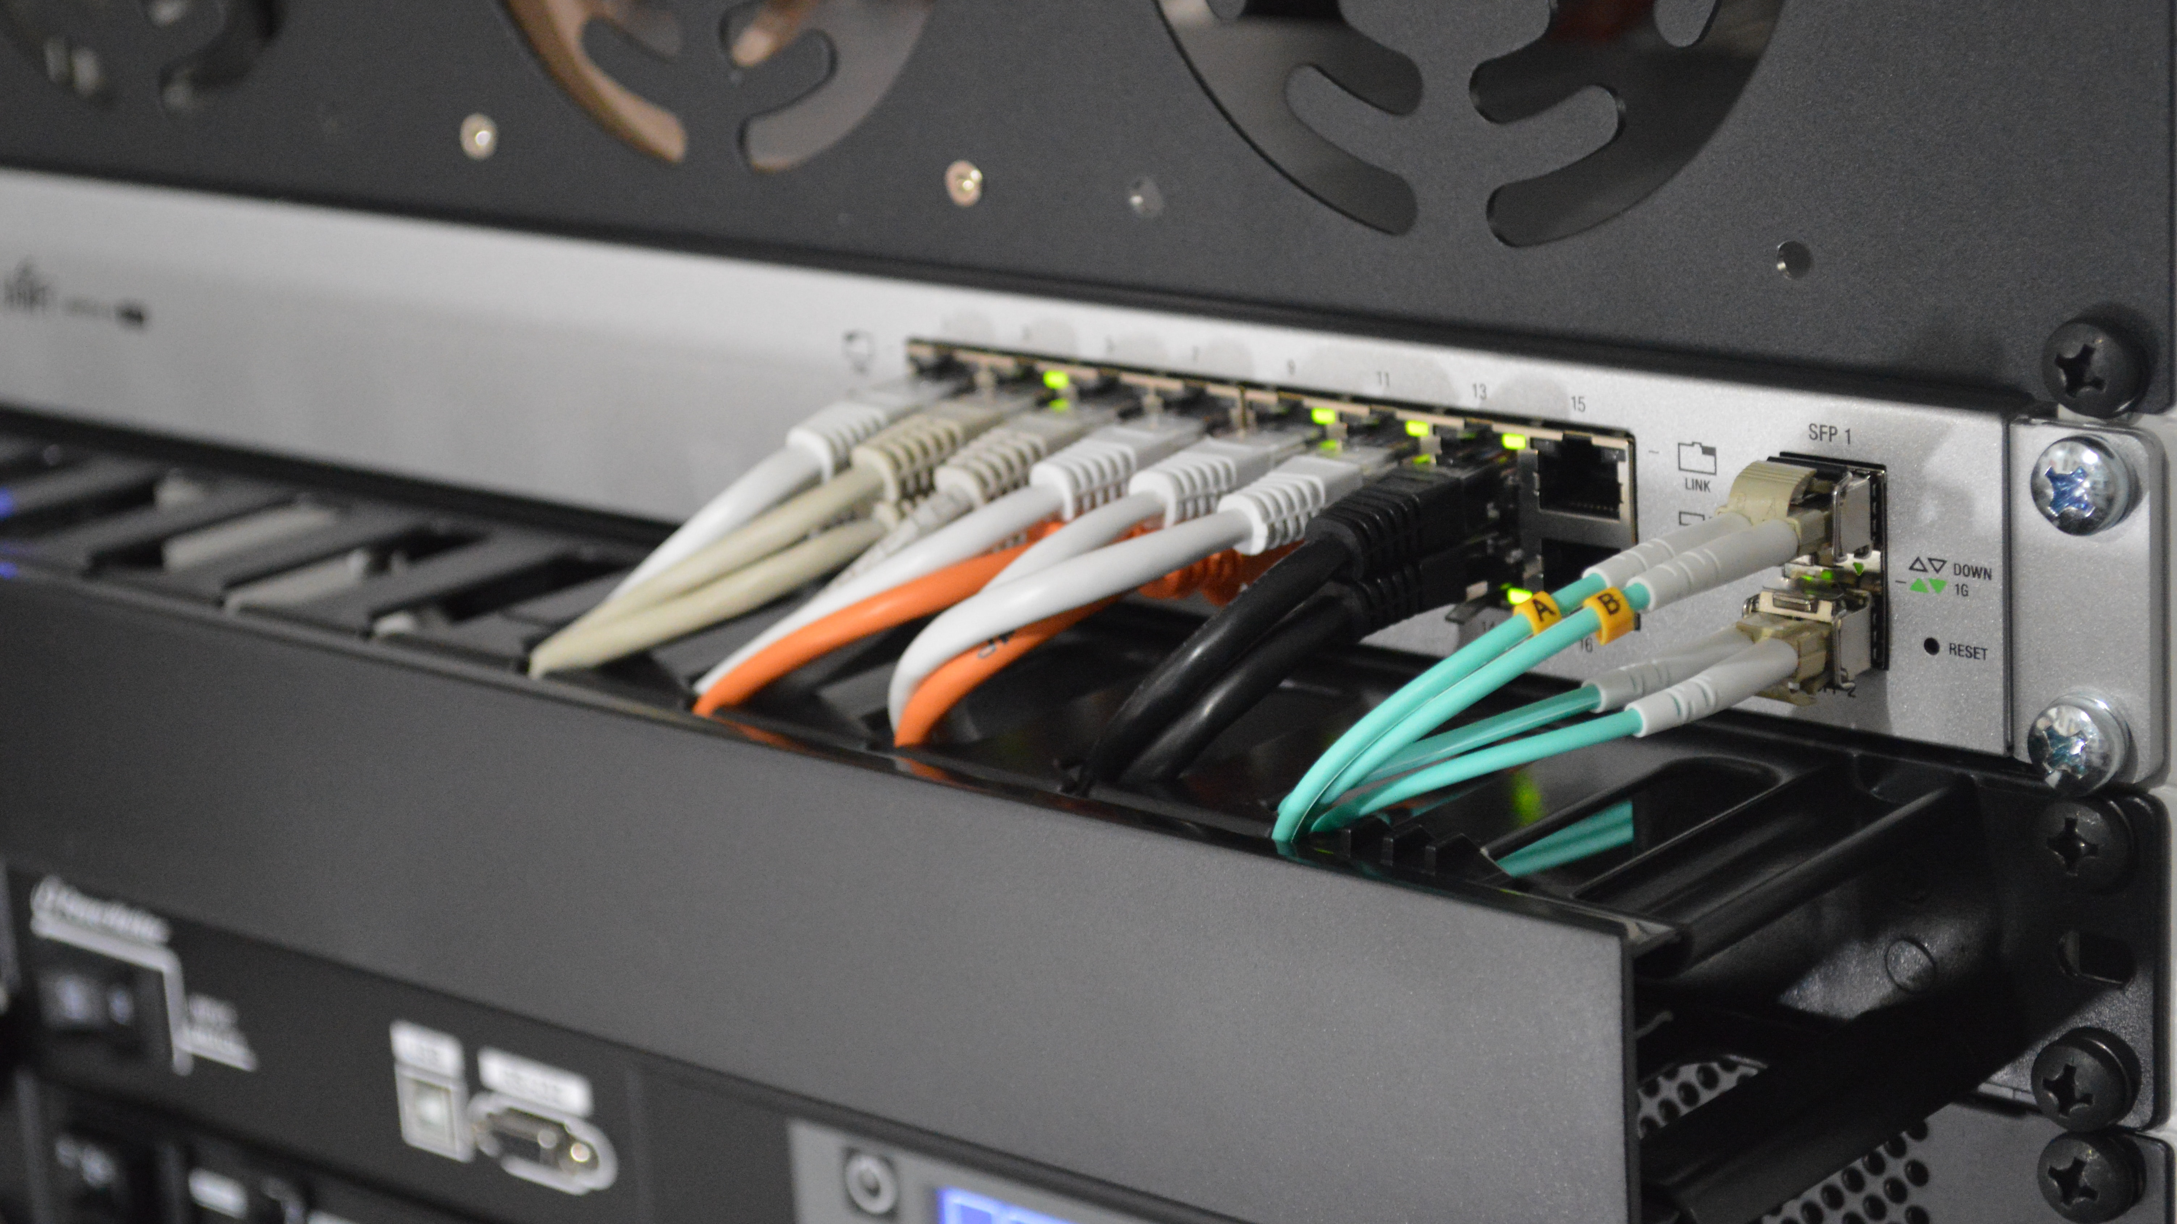
Remote Storage

Slide 16
Remote Storage
Data persists beyond lifecycle of any pod
Referenced in pod either in-line or via PV/PVC
Examples:
GCE Persistent Disk
AWS EBS
Azure Data Disk
iSCSI
NFS
GlusterFS
Cinder
Ceph File and RBD

Slide 18
Pod
Mounts PersistentVolumeClaim into container(s)

Slide 19
PersistentVolumeClaim (PVC)
Application request for storage.
Created by user / devops.
Binds to single PV.
Usable in Pods.

Slide 20
PersistentVolume (PV)
Pointer to physical storage.
Binds to single PVC.
Created by admin ("pre-provisioning").
Created by Kubernetes on demand ("dynamic provisioning").

Slide 21
StorageClass
Collection of PersistentVolumes with the same characteristics.
"Fast", "Cheap", "Replicated", ...
Parameters for dynamic provisioning.
Created by admin. Subject of quota per namespace.

Slide 22
Kubernetes Storage Entities Portability
Portable across Kubernetes clusters.
Pod
PersistentVolumeClaim (PVC)

Slide 23
Kubernetes Storage Entities Portability
Not portable across Kubernetes clusters.
PersistentVolume (PV)
StorageClass
Both contain details about the storage:
Volume plugin.
IP addresses of storage server(s).
Paths.
Usernames / passwords.

Slide 24

Stateful Pod Step by Step

Slide 25
Pod mounts PersistentVolumeClaim into container(s)
apiVersion: apps/v1
kind: Pod
metadata:
name: mysql
spec:
containers:
- image: mysql:5.6
name: mysql
env:
- name: MYSQL_ROOT_PASSWORD
value: password
volumeMounts:
- name: mysql-persistent-storage
mountPath: /var/lib/mysql
volumes:
- name: mysql-persistent-storage
persistentVolumeClaim:
claimName: mysql-pv-claim

Slide 26
PersistentVolumeClaim = request for storage
kind: PersistentVolumeClaim
apiVersion: v1
metadata:
name: mysql-pv-claim
spec:
resources:
requests:
storage: 1Gi
accessModes:
- ReadWriteOnce
"Give me 1 GiB of storage."
"That is mountable to single pod as read/write."
"And I don't really care about the rest."

Slide 27
PersistentVolumeClaim
$ kubectl create -f pvc.yaml
persistentvolumeclaim/mysql-pv-claim created
$ kubectl get pvc
NAME STATUS VOLUME CAPACITY ACCESS MODES STORAGECLASS AGE
my-mysql-claim Bound pvc-6428 1Gi RWO standard 1m

Slide 28
PersistentVolume
kind: PersistentVolume
apiVersion: v1
metadata:
name: task-pv-volume
labels:
type: local
spec:
storageClassName: cheap
capacity:
storage: 10Gi
accessModes:
- ReadWriteOnce
persistentVolumeReclaimPolicy: Retain
hostPath:
path: "/mnt/data"
StorageClass where this
volume belongs.

Slide 29
PersistentVolume
kind: PersistentVolume
apiVersion: v1
metadata:
name: task-pv-volume
labels:
type: local
spec:
storageClassName: cheap
capacity:
storage: 10Gi
accessModes:
- ReadWriteOnce
persistentVolumeReclaimPolicy: Retain
hostPath:
path: "/mnt/data"
Size of the Volume

Slide 30
PersistentVolume
kind: PersistentVolume
apiVersion: v1
metadata:
name: task-pv-volume
labels:
type: local
spec:
storageClassName: cheap
capacity:
storage: 10Gi
accessModes:
- ReadWriteOnce
persistentVolumeReclaimPolicy: Retain
hostPath:
path: "/mnt/data"
Access modes that the
volume supports

Slide 31
PersistentVolume
kind: PersistentVolume
apiVersion: v1
metadata:
name: task-pv-volume
labels:
type: local
spec:
storageClassName: cheap
capacity:
storage: 10Gi
accessModes:
- ReadWriteOnce
persistentVolumeReclaimPolicy: Retain
hostPath:
path: "/mnt/data"
What to do when the volume is
not needed any longer. Options:
Recycle (deprecated),
Retain,
Delete

Slide 32
PersistentVolume
kind: PersistentVolume
apiVersion: v1
metadata:
name: task-pv-volume
labels:
type: local
spec:
storageClassName: cheap
capacity:
storage: 10Gi
accessModes:
- ReadWriteOnce
persistentVolumeReclaimPolicy: Retain
hostPath:
path: "/mnt/data"
Pointer to Storage
AWS EBS, Azure DD, Ceph FS & RBD, CSI, FC, Flex, GCE PD, Gluster, iSCSI, NFS, OpenStack Cinder,
Photon, Quobyte, StorageOS, vSphere

Slide 33
StorageClass
kind: StorageClass
apiVersion: storage.k8s.io/v1
metadata:
name: slow
provisioner: kubernetes.io/gce-pd
annotations:
storageclass.kubernetes.io/is-default-class: "true"
parameters:
type: pd-standard
zone: us-east1-d
Collection of PersistentVolumes with the same characteristics.
Usually admin territory.
Global, not namespaced.

Slide 34
StorageClass
kind: StorageClass
apiVersion: storage.k8s.io/v1
metadata:
name: slow
provisioner: kubernetes.io/gce-pd
annotations:
storageclass.kubernetes.io/is-default-class: "true"
parameters:
type: pd-standard
zone: us-east1-d
Who dynamically provisions volumes.
Name of hardcoded volume plugin.
Name of external provisioner.
Name of CSI driver.

Slide 35
StorageClass
kind: StorageClass
apiVersion: storage.k8s.io/v1
metadata:
name: slow
provisioner: kubernetes.io/gce-pd
annotations:
storageclass.kubernetes.io/is-default-class: "true"
parameters:
type: pd-standard
zone: us-east1-d
Parameters for dynamic provisioning.
Depend on the provisioner.

Slide 36
StorageClass
kind: StorageClass
apiVersion: storage.k8s.io/v1
metadata:
name: slow
provisioner: kubernetes.io/gce-pd
annotations:
storageclass.kubernetes.io/is-default-class: "true"
parameters:
type: pd-standard
zone: us-east1-d
One StorageClass in the cluster can be default.
PVC without any StorageClass gets the default one.

Slide 37
PersistentVolume lifecycle

Slide 38
PersistentVolume – Dynamic Provisioning
Admin
Storage
Storage Class
Persistent
Volume
User
PersistentVolumeClaim

Slide 39
PersistentVolume – Manual Provisioning
Admin
Storage
Storage Class
Persistent
Volume
User
PersistentVolumeClaim

Slide 40
PersistentVolume – Release
Admin
Storage
Storage Class
Persistent
Volume
User
PersistentVolumeClaim

Slide 41
PersistentVolume – Release
PVC is deleted: persistentVolumeReclaimPolicy is executed:
Recycle (deprecated):
All data from the volume are removed ("rm -rf *").
PV is Available for new PVCs.
Delete:
Volume is deleted in the storage backend.
PV is deleted.
Usually for dynamically-provisioned volumes
Retain:
PV is kept Released.
No PVC can bind to it.
Admin should manually prune Released volumes. In all cases, user can't access the data!

Slide 42
Stateful applications

Slide 43
Deployment
Runs X replicas of a single Pod template.
When a pod is deleted, Deployment automatically creates a new one.
Scalable up & down.
All pods share the same PVC!

Slide 44
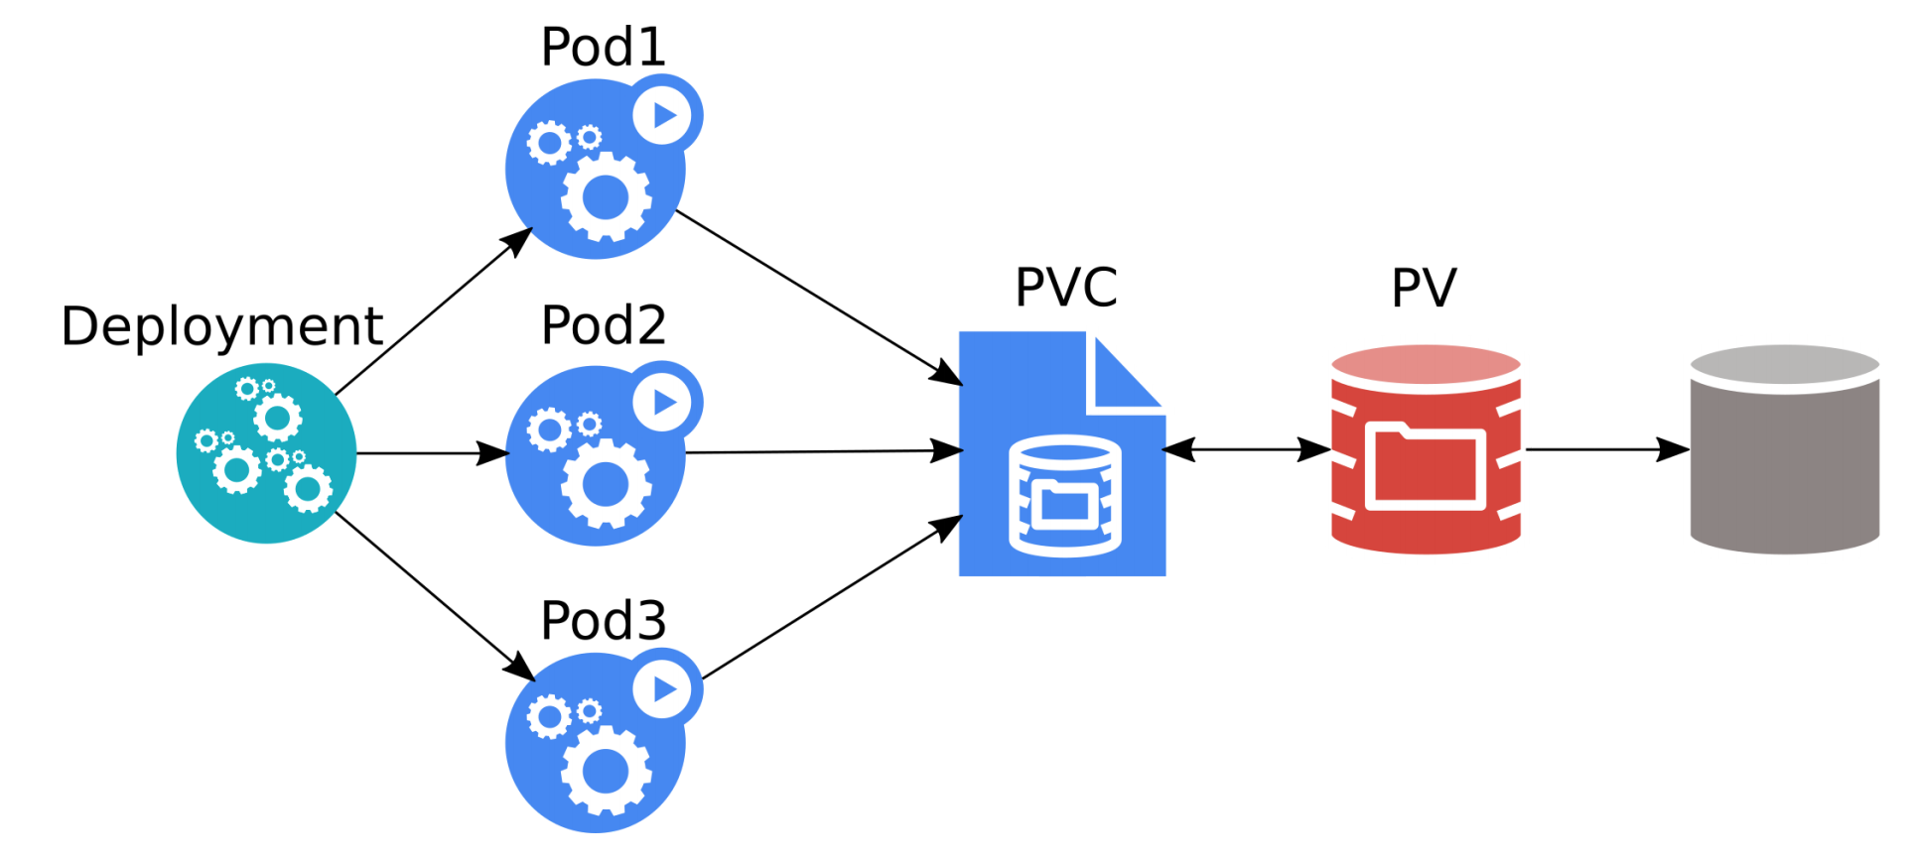
Deployment
Source: Kubernetes Storage 101 - Jan Šafránek, Red Hat & David Zhu, Google

Slide 45
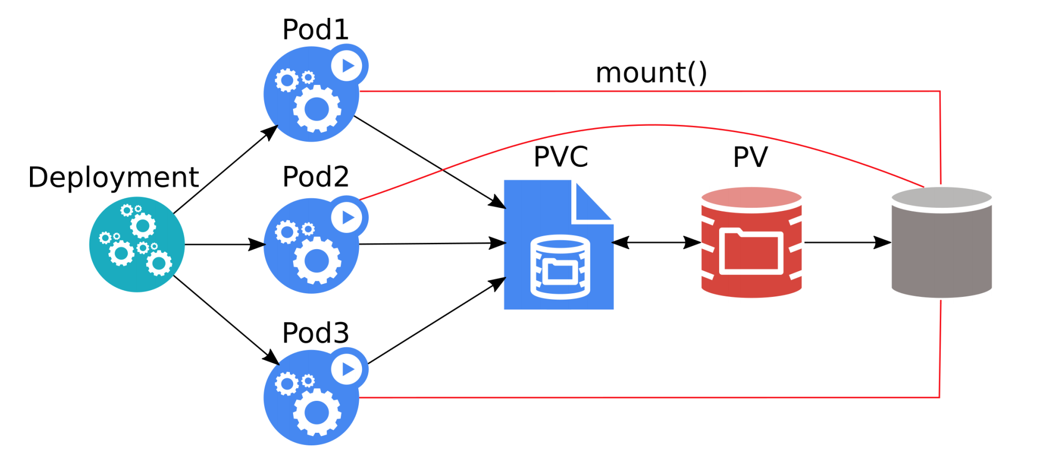
Deployment
All three pods can overwrite data of each other!
Most applications crash / refuse to work.
Source: Kubernetes Storage 101 - Jan Šafránek, Red Hat & David Zhu, Google

Slide 46
StatefulSet
Runs X replicas of a single Pod template.
Each pod gets its own PVC(s) from a PVC template.
When a pod is deleted, StatefulSet automatically creates a new one.
Each pod has a stable identity.
Scalable up & down.

Slide 47
StatefulSet
Slajd z porownaniem jak zmienia sie YAML miedzy StatefulSet’em a Deploymentem

Slide 48
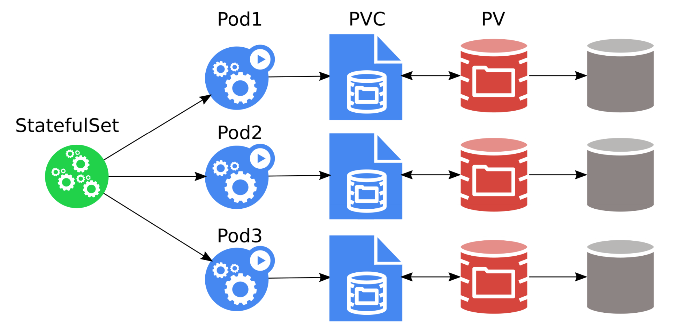
StatefulSet
The pods must be aware of the other StatefulSet members!
Source: Kubernetes Storage 101 - Jan Šafránek, Red Hat & David Zhu, Google

Slide 49

Storage features

Slide 50
Local Volumes
Unused local disks can be used as PVs.
Extra speed.
Lower reliability.
No pod scheduling flexibility.

Slide 51
Resize
Only expansion is supported.
Offline.
Online (alpha).

Slide 52
Snapshots
Alpha.
Part of CSI.
Can take a snapshot of PVC.
PVC can be provisioned from a snapshot.
More: https://kubernetes.io/blog/2018/10/09/introducing-volume-snapshot-alpha-for-kubernetes/

Slide 53


Slide 54
CSI = Container Storage Interface
Container Storage Interface (CSI) is an initiative to unify the storage interface of Container Orchestrator Systems (COs) like Kubernetes, Mesos, Docker swarm, cloud foundry, etc.
Implementing a single CSI for a storage vendor is guaranteed to work with all COs.

Slide 55
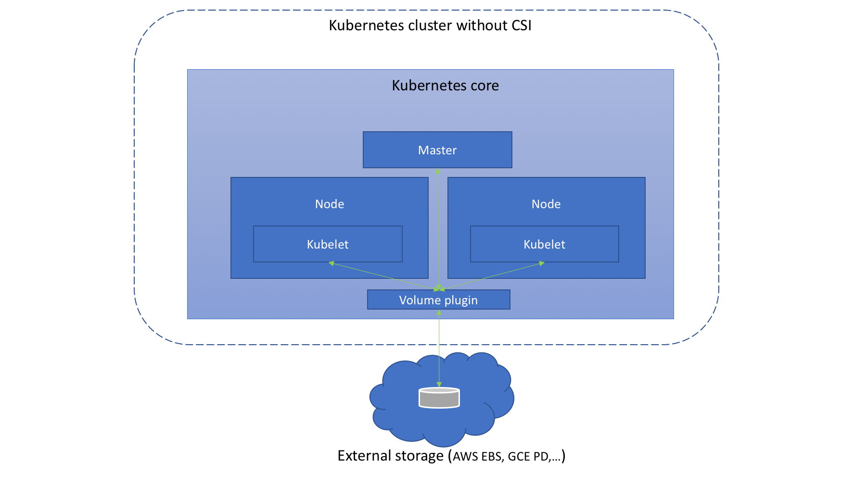
Before CSI
Source: https://medium.com/google-cloud/understanding-the-container-storage-interface-csi-ddbeb966a3b

Slide 56
Before CSI - problems
Volume plugin development coupled and dependent on Kubernetes releases.
Kubernetes developers/community are responsible for testing and maintaining all volume plugins.
Bugs in volume plugins can crash Kubernetes core components
Volume plugins get full privileges of kubernetes components (kubelet and kube-controller-manager).
Plugin developers are forced to make plugin source code available – open-source

Slide 57
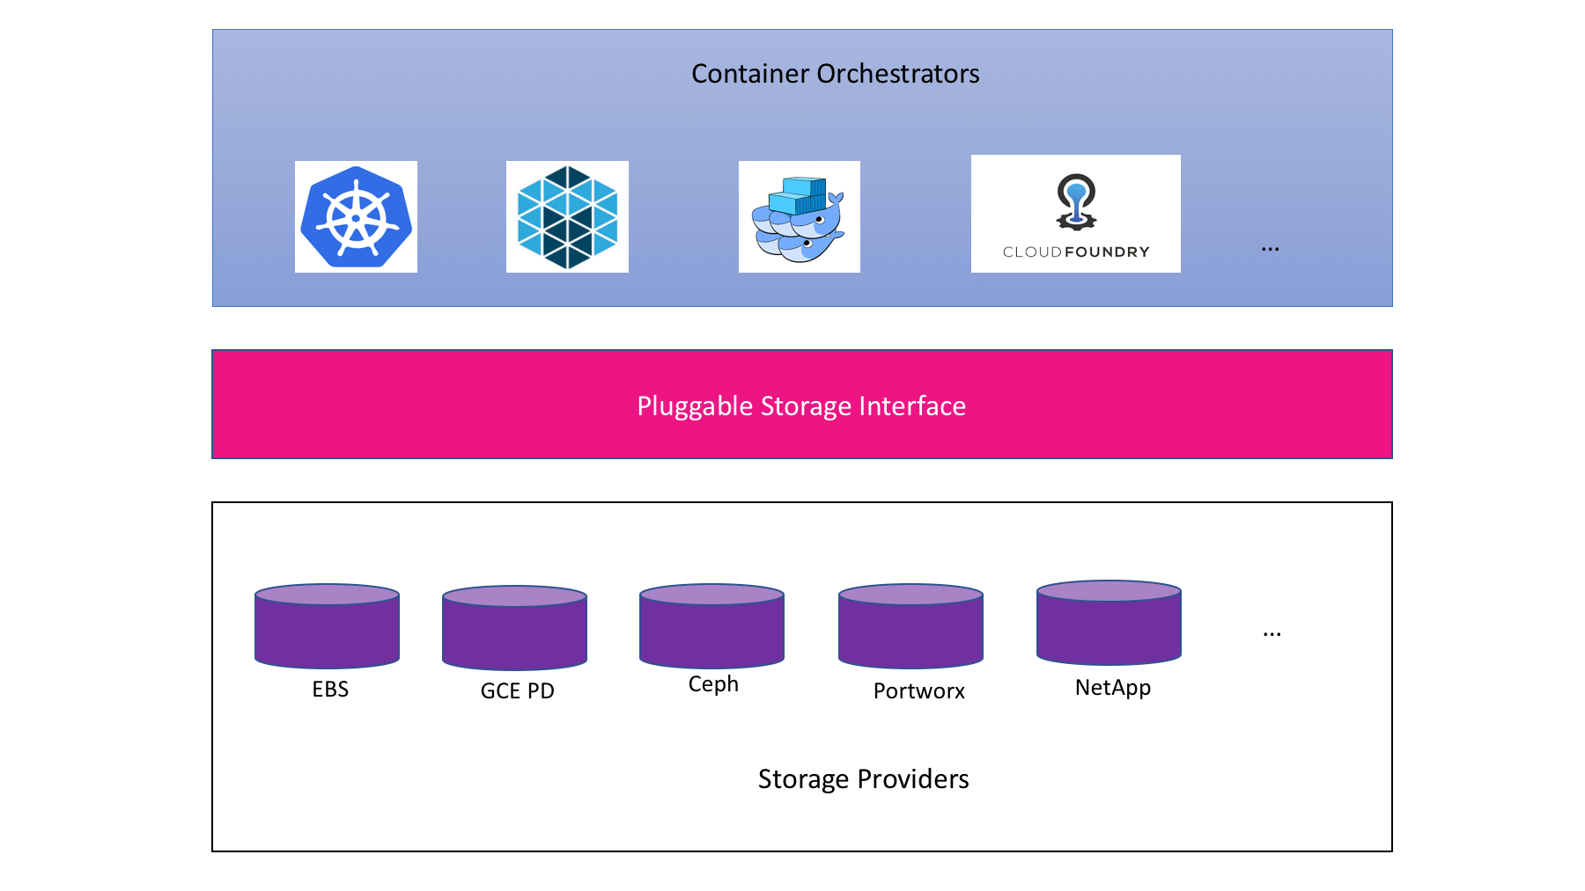
CSI concept
Source: CloudNativeCon EU 2018 CSI Jie Yu

Slide 58
CSI exmaple
kind: StorageClass
apiVersion: storage.k8s.io/v1
metadata:
name: fast-storage
provisioner: csi-driver.example.com
parameters:
type: pd-ssd
csi.storage.k8s.io/provisioner-secret-name: mysecret
csi.storage.k8s.io/provisioner-secret-namespace: mynamespace

Slide 59
CSI – materials
Webpage - https://kubernetes-csi.github.io/
Specification - https://github.com/container-storage-interface/spec
Great talks:
Container Storage Interface: Present and Future - Jie Yu
Container Storage Interface for Kubernetes

Slide 60


Slide 61
Myth 1: Applications in containers must be stateless

Slide 62
Myth 2: Writes done by container apps are slow
https://www.youtube.com/watch?v=4V-4yPSfN3U
Benchmarking Cloud Native Storage - Josh Berkus, Red Hat – KubeCon Europe 2019
hostPath and Local Volume as fast as Local Volume
Perf depends on cloud provider

Slide 63
Myth 3: storing data on k8s requires distributed storage

Slide 64
Myth 4: Never run DB on k8s

Slide 65

Summary

Slide 66
Takeaways

Slide 67

Q&A

